Slide 1
Application Delivery Fundamentals 2.0: Java Module 26: Introduction to Spring Framework
Notes:
Module Duration: 2 hours 30 minutes

Slide 2

Module Objectives
At the end of this module, participants will be able to:
Explain the advantages of the Spring Framework
List the Spring Framework components
Write/Modify an Application Based on Spring Core
Describe Dependency Injection
Identify the two distinct Spring containers:
BeanFactory
ApplicationContext
2
Notes:
Faculty Notes:
Review the objectives for the module.
Participant Notes:
N/A

Slide 3
Agenda
Spring Framework Background
Problems with Traditional Approach
Goals of Spring Framework
Spring Framework Components
Spring Containers
Spring Core
Activity 1: Spring Core
3
Notes:
Faculty Notes:
Briefly review the module agenda.
Participant Notes:
N/A

Slide 4

Spring Framework Background
Simplified development of enterprise applications in Java technologies
Started around 2002-2003 by Rod Johnson
Open-source application framework for Java platform
Layered architecture; allows selection of components based on requirements
Easy way to configure and resolve dependencies using Inversion of Control (IoC)
4
Notes:
Facilitator Notes:
Review information on the slide and in the participant notes.
Inversion of Control (IoC) will be discussed later in this module.
Participants Notes:
Spring:
Makes Java EE and existing technologies easy to use.
Organizes business objects in an effective manner with configuration management mechanisms.
Is platform-independent: There is portability between different application servers.

Slide 5
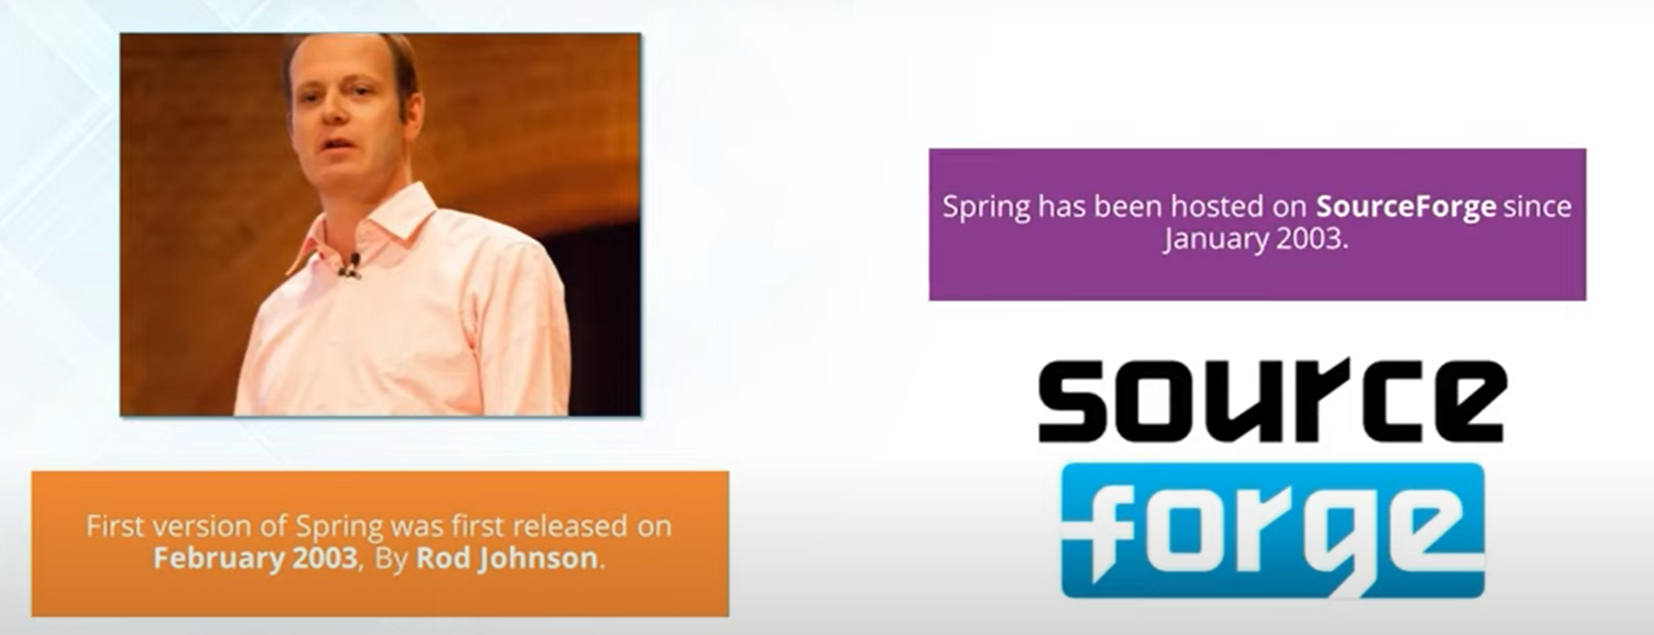
Spring Framework Background
4
Notes:
Facilitator Notes:
Review information on the slide and in the participant notes.
Inversion of Control (IoC) will be discussed later in this module.
Participants Notes:
Spring:
Makes Java EE and existing technologies easy to use.
Organizes business objects in an effective manner with configuration management mechanisms.
Is platform-independent: There is portability between different application servers.

Slide 6

Problems in Traditional Programming vs. Spring Core
Tight Coupling
Classes directly create objects using new.
If one class changes, dependent classes must also change.
class Service {
private Repository repo = new Repository(); // tightly coupled
}
5
Notes:
Faculty Notes:
Review key slide points and participant notes.
Participant Notes:
Problems with JavaEE traditional approach include:
JavaEE applications are complex and contain excessive amounts of "plumbing" code.
Often, Java code includes a high proportion of code that is not related to business logic, such as try/catch blocks used to acquire and release JDBC resources, lookups for resources, and so on.
Writing excessive plumbing code is a major drain on resources.
It is better for code to focus on business logic.
JavaEE applications are difficult to unit test.
The JavaEE APIs are not designed to take into account ease of unit testing.
Generally an application server is needed to test JavaEE applications. Spring framework does not need an application server to run.
Spring has mock objects which can substitute for real objects and make testing easier.
Certain JavaEE technologies have failed in performance.
For example EJB 2.x: Generally, entity beans are used for database operations but are a nightmare for productivity.
Note, a bean is an object which is managed by Spring Container. All java classes are also treated as beans.

Slide 7
Problems in Traditional Programming vs. Spring Core
Difficult Testing
Because dependencies are hard-coded, you cannot easily inject mock objects.
Unit testing becomes painful since you must rely on real implementations.
5
Notes:
Faculty Notes:
Review key slide points and participant notes.
Participant Notes:
Problems with JavaEE traditional approach include:
JavaEE applications are complex and contain excessive amounts of "plumbing" code.
Often, Java code includes a high proportion of code that is not related to business logic, such as try/catch blocks used to acquire and release JDBC resources, lookups for resources, and so on.
Writing excessive plumbing code is a major drain on resources.
It is better for code to focus on business logic.
JavaEE applications are difficult to unit test.
The JavaEE APIs are not designed to take into account ease of unit testing.
Generally an application server is needed to test JavaEE applications. Spring framework does not need an application server to run.
Spring has mock objects which can substitute for real objects and make testing easier.
Certain JavaEE technologies have failed in performance.
For example EJB 2.x: Generally, entity beans are used for database operations but are a nightmare for productivity.
Note, a bean is an object which is managed by Spring Container. All java classes are also treated as beans.

Slide 8
Problems in Traditional Programming vs. Spring Core
Code Duplication for Cross-Cutting Concerns
Features like logging, security, transaction management are repeated in multiple places.
Leads to boilerplate and harder maintenance.
5
Notes:
Faculty Notes:
Review key slide points and participant notes.
Participant Notes:
Problems with JavaEE traditional approach include:
JavaEE applications are complex and contain excessive amounts of "plumbing" code.
Often, Java code includes a high proportion of code that is not related to business logic, such as try/catch blocks used to acquire and release JDBC resources, lookups for resources, and so on.
Writing excessive plumbing code is a major drain on resources.
It is better for code to focus on business logic.
JavaEE applications are difficult to unit test.
The JavaEE APIs are not designed to take into account ease of unit testing.
Generally an application server is needed to test JavaEE applications. Spring framework does not need an application server to run.
Spring has mock objects which can substitute for real objects and make testing easier.
Certain JavaEE technologies have failed in performance.
For example EJB 2.x: Generally, entity beans are used for database operations but are a nightmare for productivity.
Note, a bean is an object which is managed by Spring Container. All java classes are also treated as beans.

Slide 9
Problems in Traditional Programming vs. Spring Core
Manual Object Lifecycle Management
Developers must handle initialization, configuration, and cleanup of objects.
High risk of resource leaks (e.g., not closing connections properly).
5
Notes:
Faculty Notes:
Review key slide points and participant notes.
Participant Notes:
Problems with JavaEE traditional approach include:
JavaEE applications are complex and contain excessive amounts of "plumbing" code.
Often, Java code includes a high proportion of code that is not related to business logic, such as try/catch blocks used to acquire and release JDBC resources, lookups for resources, and so on.
Writing excessive plumbing code is a major drain on resources.
It is better for code to focus on business logic.
JavaEE applications are difficult to unit test.
The JavaEE APIs are not designed to take into account ease of unit testing.
Generally an application server is needed to test JavaEE applications. Spring framework does not need an application server to run.
Spring has mock objects which can substitute for real objects and make testing easier.
Certain JavaEE technologies have failed in performance.
For example EJB 2.x: Generally, entity beans are used for database operations but are a nightmare for productivity.
Note, a bean is an object which is managed by Spring Container. All java classes are also treated as beans.

Slide 10
Problems in Traditional Programming vs. Spring Core
Scattered Configuration
Configuration details (database URLs, credentials, service endpoints) are spread across classes.
Makes migration and environment changes (dev → test → prod) error-prone.
5
Notes:
Faculty Notes:
Review key slide points and participant notes.
Participant Notes:
Problems with JavaEE traditional approach include:
JavaEE applications are complex and contain excessive amounts of "plumbing" code.
Often, Java code includes a high proportion of code that is not related to business logic, such as try/catch blocks used to acquire and release JDBC resources, lookups for resources, and so on.
Writing excessive plumbing code is a major drain on resources.
It is better for code to focus on business logic.
JavaEE applications are difficult to unit test.
The JavaEE APIs are not designed to take into account ease of unit testing.
Generally an application server is needed to test JavaEE applications. Spring framework does not need an application server to run.
Spring has mock objects which can substitute for real objects and make testing easier.
Certain JavaEE technologies have failed in performance.
For example EJB 2.x: Generally, entity beans are used for database operations but are a nightmare for productivity.
Note, a bean is an object which is managed by Spring Container. All java classes are also treated as beans.

Slide 11
Problems in Traditional Programming vs. Spring Core
Hard to Maintain
As the system grows, dependencies become a web of connections.
Changes in one module ripple across others.
5
Notes:
Faculty Notes:
Review key slide points and participant notes.
Participant Notes:
Problems with JavaEE traditional approach include:
JavaEE applications are complex and contain excessive amounts of "plumbing" code.
Often, Java code includes a high proportion of code that is not related to business logic, such as try/catch blocks used to acquire and release JDBC resources, lookups for resources, and so on.
Writing excessive plumbing code is a major drain on resources.
It is better for code to focus on business logic.
JavaEE applications are difficult to unit test.
The JavaEE APIs are not designed to take into account ease of unit testing.
Generally an application server is needed to test JavaEE applications. Spring framework does not need an application server to run.
Spring has mock objects which can substitute for real objects and make testing easier.
Certain JavaEE technologies have failed in performance.
For example EJB 2.x: Generally, entity beans are used for database operations but are a nightmare for productivity.
Note, a bean is an object which is managed by Spring Container. All java classes are also treated as beans.

Slide 12
Problems in Traditional Programming vs. Spring Core
Lack of Flexibility
Swapping an implementation (e.g., change database from MySQL to Oracle) requires code changes and recompilation.
No separation between configuration and application logic.
5
Notes:
Faculty Notes:
Review key slide points and participant notes.
Participant Notes:
Problems with JavaEE traditional approach include:
JavaEE applications are complex and contain excessive amounts of "plumbing" code.
Often, Java code includes a high proportion of code that is not related to business logic, such as try/catch blocks used to acquire and release JDBC resources, lookups for resources, and so on.
Writing excessive plumbing code is a major drain on resources.
It is better for code to focus on business logic.
JavaEE applications are difficult to unit test.
The JavaEE APIs are not designed to take into account ease of unit testing.
Generally an application server is needed to test JavaEE applications. Spring framework does not need an application server to run.
Spring has mock objects which can substitute for real objects and make testing easier.
Certain JavaEE technologies have failed in performance.
For example EJB 2.x: Generally, entity beans are used for database operations but are a nightmare for productivity.
Note, a bean is an object which is managed by Spring Container. All java classes are also treated as beans.

Slide 13
Problems in Traditional Programming vs. Spring Core
Late Error Detection
Dependency issues (missing objects, wrong initialization order) surface only at runtime.
Debugging becomes time-consuming.
5
Notes:
Faculty Notes:
Review key slide points and participant notes.
Participant Notes:
Problems with JavaEE traditional approach include:
JavaEE applications are complex and contain excessive amounts of "plumbing" code.
Often, Java code includes a high proportion of code that is not related to business logic, such as try/catch blocks used to acquire and release JDBC resources, lookups for resources, and so on.
Writing excessive plumbing code is a major drain on resources.
It is better for code to focus on business logic.
JavaEE applications are difficult to unit test.
The JavaEE APIs are not designed to take into account ease of unit testing.
Generally an application server is needed to test JavaEE applications. Spring framework does not need an application server to run.
Spring has mock objects which can substitute for real objects and make testing easier.
Certain JavaEE technologies have failed in performance.
For example EJB 2.x: Generally, entity beans are used for database operations but are a nightmare for productivity.
Note, a bean is an object which is managed by Spring Container. All java classes are also treated as beans.

Slide 14
Pain Points Addresses By Spring Core
Paint Points
IoC (Inversion of Control) Container for object creation & lifecycle.
Dependency Injection for decoupling.
AOP (Aspect-Oriented Programming) for cross-cutting concerns.
Centralized configuration using properties and profiles.
5
Notes:
Faculty Notes:
Review key slide points and participant notes.
Participant Notes:
Problems with JavaEE traditional approach include:
JavaEE applications are complex and contain excessive amounts of "plumbing" code.
Often, Java code includes a high proportion of code that is not related to business logic, such as try/catch blocks used to acquire and release JDBC resources, lookups for resources, and so on.
Writing excessive plumbing code is a major drain on resources.
It is better for code to focus on business logic.
JavaEE applications are difficult to unit test.
The JavaEE APIs are not designed to take into account ease of unit testing.
Generally an application server is needed to test JavaEE applications. Spring framework does not need an application server to run.
Spring has mock objects which can substitute for real objects and make testing easier.
Certain JavaEE technologies have failed in performance.
For example EJB 2.x: Generally, entity beans are used for database operations but are a nightmare for productivity.
Note, a bean is an object which is managed by Spring Container. All java classes are also treated as beans.

Slide 15
Traditional Programming vs Spring Core
Area | Traditional / Manual DI | Spring Core (IoC + AOP)
Object creation & wiring | new everywhere; constructors call other constructors; hard to visualize dependencies | IoC container creates and wires beans; constructor/field/setter injection makes wiring explicit
Coupling | Classes know concrete types → tight coupling | Interfaces + DI → swap implementations by config/profile; promotes loose coupling
Testability | Newing dependencies makes mocking hard; heavy setup | Inject mocks/stubs in tests; use @TestConfiguration, @MockBean
Configuration drift | Scattered constants, env flags, hand-rolled config loaders | Environment abstraction, @Value, @ConfigurationProperties, profile-specific props
Lifecycle management | Manual init/cleanup; risk of leaks | Bean lifecycle callbacks (@PostConstruct, @PreDestroy), scopes (singleton, prototype, request, session)
Cross-cutting concerns | Duplicated logging, transactions, caching, security; copy-paste | AOP: declarative @Transactional, @Cacheable, security via Spring Security, logging interceptors

Slide 16
Traditional Programming vs Spring Core
Reusability | Hard to reuse because wiring is embedded | Component scanning + stereotypes (@Component, @Service, @Repository) make modules plug-and-play
Configuration style | Custom factories and singletons | @Configuration + @Bean methods; consistent factory semantics
Runtime flexibility | Changing an impl means code changes & rebuild | Swap beans via profiles, conditional beans, externalized properties
Error visibility | Fail late at runtime | Context startup validation (unsatisfied deps, cycles) → fail fast
Observability | Ad-hoc logging | Built-in events (ApplicationEventPublisher), actuator (if using Boot)

Slide 17
Framework
A framework is a pre-built structure or skeleton that provides reusable libraries, components, and guidelines to build software applications efficiently.
Unlike a library (where you call the code), in a framework the framework calls your code — this is called Inversion of Control (IoC).

Slide 18
Key Characteristics of Framework
Inversion of Control (IoC)
Instead of you controlling the flow, the framework controls the flow and plugs in your code where required.
Reusability
Provides reusable tools, libraries, and components (e.g., logging, security, database connectivity).
Standardization
Defines a consistent structure, reducing ad-hoc coding styles.
Extensibility
You can extend it with plugins or modules.
Productivity Boost
Saves time by avoiding boilerplate code and giving ready-to-use utilities.

Slide 19
Types of Frameworks
Web Frameworks – For building web apps
Examples: Spring (Java), ASP.NET (C#), Django (Python), Angular (TS/JS).
Mobile Frameworks – For mobile development
Examples: Flutter, React Native, Xamarin.
Data/ORM Frameworks – For database interaction
Examples: Hibernate (Java), Entity Framework (C#), Sequelize (Node.js).
Testing Frameworks – For automated testing
Examples: JUnit, NUnit, PyTest, Jasmine.

Slide 20
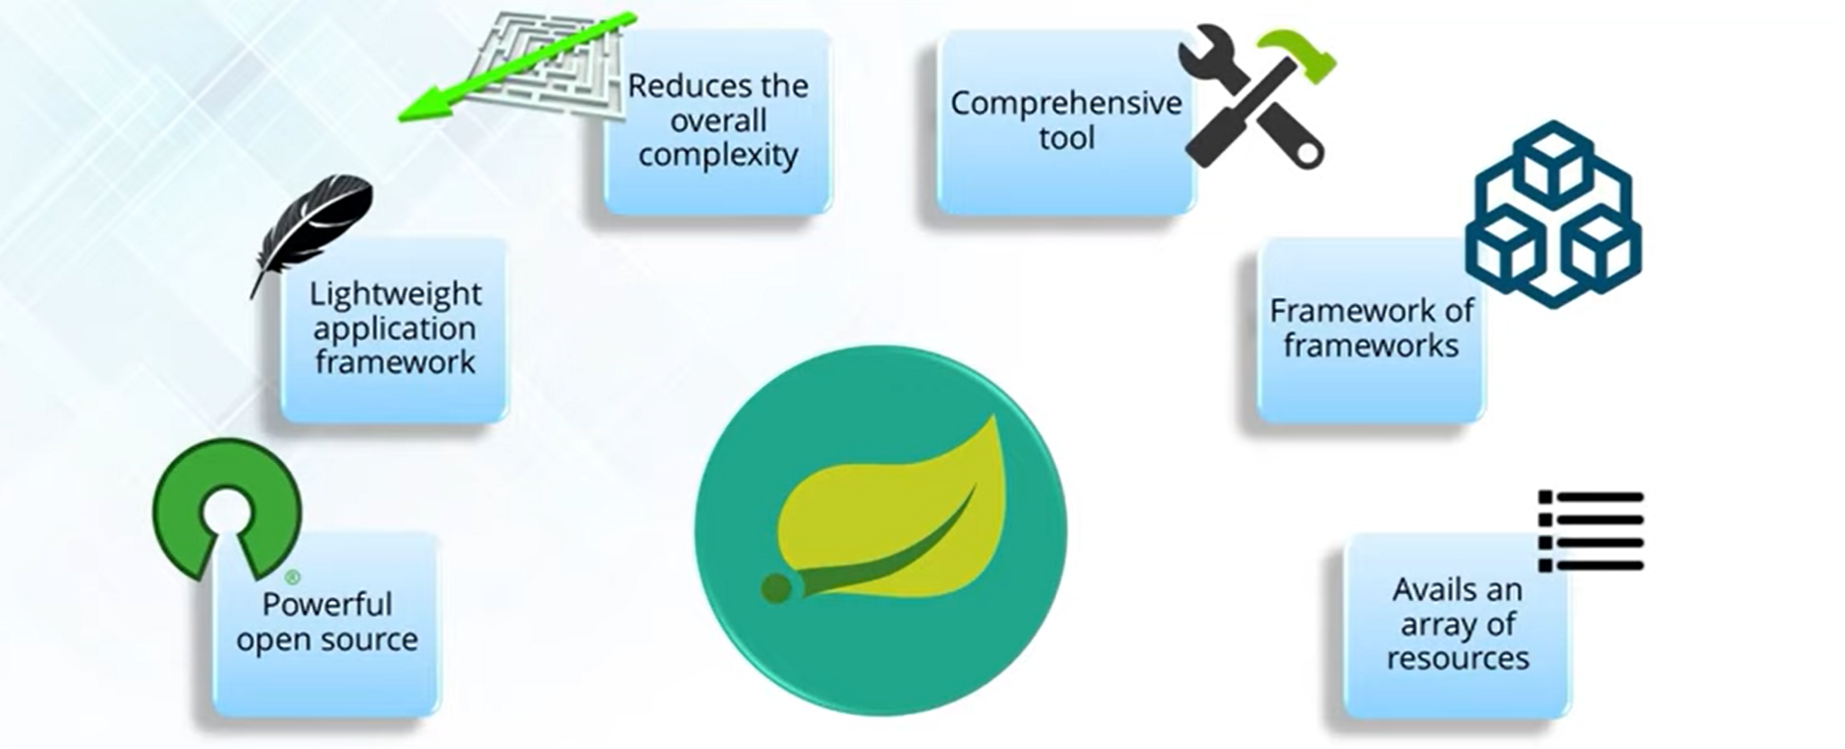
Spring Framework

Slide 21
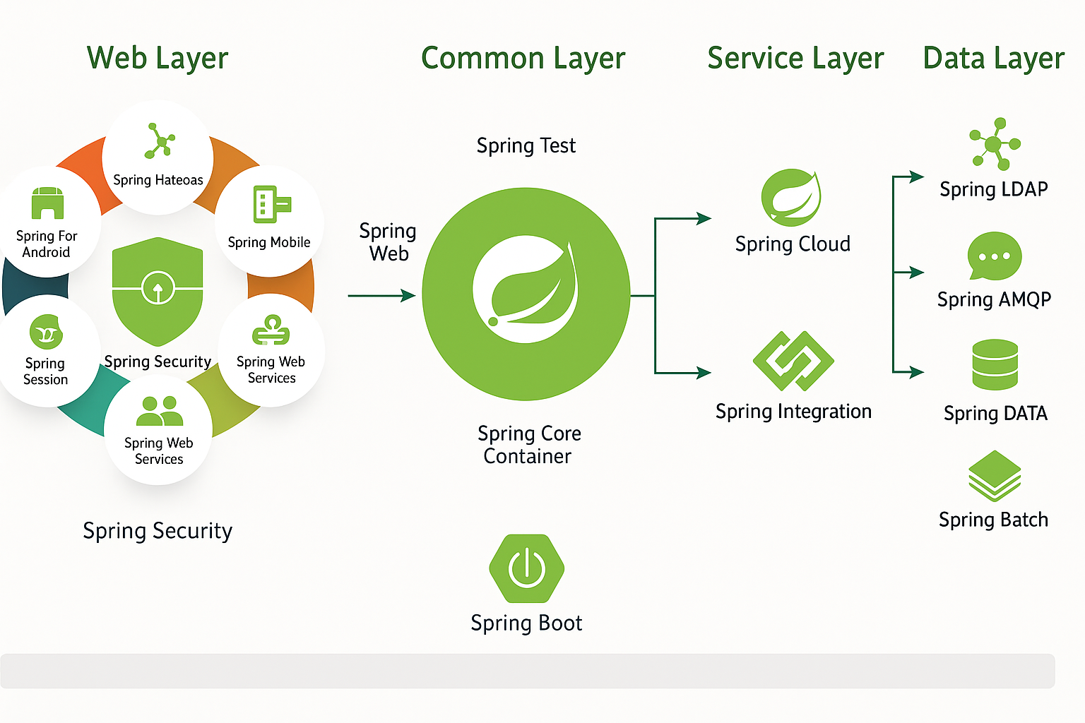
Spring Framework

Slide 22
Spring Framework
Web Layer
Focus: Web-based modules for building web apps and REST APIs.
Components:
Spring Web / Web MVC → Core web framework for MVC pattern.
Spring Web Flow → Manages navigation flows in web apps.
Spring Session → Session management across clustered apps.
Spring Web Services → SOAP-based web service support.
Spring Mobile → Mobile web app features.
Spring HATEOAS → REST APIs with hypermedia controls.
Spring Social → Integration with social networks.
Spring for Android → Client-side Android support.
Spring Security (centerpiece) → Authentication & authorization.

Slide 23
Spring framework
Common Layer
Provides core capabilities used across all other layers.
Modules:
Spring Core Container → BeanFactory, ApplicationContext, IoC container.
Spring AOP → Aspect-Oriented Programming (logging, security, transactions).
Spring Web → Common web utilities.
Spring Messaging → Abstraction for message-based systems (e.g., STOMP, WebSocket).
Spring Test → Testing framework integration (JUnit/TestNG).

Slide 24
Spring framework
Service Layer
Focus: Enterprise service integration and cloud-native development.
Modules:
Spring Data Access → DAO support, JDBC abstraction.
Spring Integration → Enterprise Integration Patterns (EIP).
Spring Cloud → Microservices/cloud-native architecture (config, discovery, resiliency).

Slide 25
Spring framework
Data Layer
Focus: Persistence and batch processing.
Modules:
Spring DATA → Unified repository abstraction for relational & NoSQL DBs.
Spring Batch → Batch processing and job scheduling.
Spring AMQP → Messaging with RabbitMQ.
Spring LDAP → Directory access via LDAP.
Spring XD (now replaced by Spring Cloud Data Flow) → Big data and streaming pipelines.

Slide 26
Spring framework
Foundation Layer
Spring IO Platform → Dependency management (now retired).
Spring Boot → Convention-over-configuration, auto-configuration, starter dependencies.
Acts as the entry point for modern Spring applications.

Slide 27
Goals of Spring Framework
1. Simplify Enterprise Java Development
Traditional J2EE (EJBs, XML configs) was heavy and complex.
Spring reduces boilerplate and provides a simpler programming model.
2. Promote Loose Coupling
By using Dependency Injection (DI) and Inversion of Control (IoC).
Classes depend on interfaces, not implementations → easier to swap modules.
6
Notes:
Faculty Notes:
Review key slide points and participant notes.
Animation on slide:
On display: Reduced glue code/plumbing work and Flexibility labels
On first click: Reduced glue information appears.
On second click: Flexibility information appears.
Participant Notes:
Spring Framework-specific classes and interfaces are used to make use of Spring. The entire process is simplified with the use of annotations. By using annotations, we do not explicitly implement/extend Spring framework-specific interfaces or classes.
Spring framework:
Reduces glue code /plumbing work:
Spring Framework takes the burden away from the programmer by providing dependencies when required. Programmers do not create any objects that they don’t need. With the Spring framework, objects are created automatically.
Provides flexibility:
Programmers are free to choose the modules that suit their application. Spring has a well-layered architecture of seven modules. It also offers many extension points to plug in other frameworks.

Slide 28
Goals of Spring Framework
3. Enable Reusability & Modularity
Encourages separation of concerns (SoC).
Different layers (Web, Data, Service, Security) are modular and reusable.
4. Support Cross-Cutting Concerns
Common concerns like logging, security, caching, and transaction management are handled by AOP (Aspect-Oriented Programming) instead of duplicating code.
6
Notes:
Faculty Notes:
Review key slide points and participant notes.
Animation on slide:
On display: Reduced glue code/plumbing work and Flexibility labels
On first click: Reduced glue information appears.
On second click: Flexibility information appears.
Participant Notes:
Spring Framework-specific classes and interfaces are used to make use of Spring. The entire process is simplified with the use of annotations. By using annotations, we do not explicitly implement/extend Spring framework-specific interfaces or classes.
Spring framework:
Reduces glue code /plumbing work:
Spring Framework takes the burden away from the programmer by providing dependencies when required. Programmers do not create any objects that they don’t need. With the Spring framework, objects are created automatically.
Provides flexibility:
Programmers are free to choose the modules that suit their application. Spring has a well-layered architecture of seven modules. It also offers many extension points to plug in other frameworks.

Slide 29
Goals of Spring Framework
3. Enable Reusability & Modularity
Encourages separation of concerns (SoC).
Different layers (Web, Data, Service, Security) are modular and reusable.
4. Support Cross-Cutting Concerns
Common concerns like logging, security, caching, and transaction management are handled by AOP (Aspect-Oriented Programming) instead of duplicating code.
6
Notes:
Faculty Notes:
Review key slide points and participant notes.
Animation on slide:
On display: Reduced glue code/plumbing work and Flexibility labels
On first click: Reduced glue information appears.
On second click: Flexibility information appears.
Participant Notes:
Spring Framework-specific classes and interfaces are used to make use of Spring. The entire process is simplified with the use of annotations. By using annotations, we do not explicitly implement/extend Spring framework-specific interfaces or classes.
Spring framework:
Reduces glue code /plumbing work:
Spring Framework takes the burden away from the programmer by providing dependencies when required. Programmers do not create any objects that they don’t need. With the Spring framework, objects are created automatically.
Provides flexibility:
Programmers are free to choose the modules that suit their application. Spring has a well-layered architecture of seven modules. It also offers many extension points to plug in other frameworks.

Slide 30
Goals of Spring Framework
5. Provide Declarative Programming
Annotations (@Transactional, @Cacheable, @Service) simplify configuration.
Declarative style makes code cleaner and more maintainable.
6. Enhance Testability
Easy to inject mocks and stubs for unit testing.
Built-in Spring Test support with JUnit/TestNG.
6
Notes:
Faculty Notes:
Review key slide points and participant notes.
Animation on slide:
On display: Reduced glue code/plumbing work and Flexibility labels
On first click: Reduced glue information appears.
On second click: Flexibility information appears.
Participant Notes:
Spring Framework-specific classes and interfaces are used to make use of Spring. The entire process is simplified with the use of annotations. By using annotations, we do not explicitly implement/extend Spring framework-specific interfaces or classes.
Spring framework:
Reduces glue code /plumbing work:
Spring Framework takes the burden away from the programmer by providing dependencies when required. Programmers do not create any objects that they don’t need. With the Spring framework, objects are created automatically.
Provides flexibility:
Programmers are free to choose the modules that suit their application. Spring has a well-layered architecture of seven modules. It also offers many extension points to plug in other frameworks.

Slide 31
Goals of Spring Framework
7. Centralized Configuration & Flexibility
Externalize configs (application.properties, YAML, profiles).
Easily adapt the same app for dev/test/prod environments.
8. Integration with Other Frameworks
Plays well with Hibernate, JPA, JMS, Kafka, RabbitMQ, security frameworks, etc.
Bridges legacy code with modern practices.
6
Notes:
Faculty Notes:
Review key slide points and participant notes.
Animation on slide:
On display: Reduced glue code/plumbing work and Flexibility labels
On first click: Reduced glue information appears.
On second click: Flexibility information appears.
Participant Notes:
Spring Framework-specific classes and interfaces are used to make use of Spring. The entire process is simplified with the use of annotations. By using annotations, we do not explicitly implement/extend Spring framework-specific interfaces or classes.
Spring framework:
Reduces glue code /plumbing work:
Spring Framework takes the burden away from the programmer by providing dependencies when required. Programmers do not create any objects that they don’t need. With the Spring framework, objects are created automatically.
Provides flexibility:
Programmers are free to choose the modules that suit their application. Spring has a well-layered architecture of seven modules. It also offers many extension points to plug in other frameworks.

Slide 32
Goals of Spring Framework
9. Support for Modern Architectures
First for monolithic applications (Spring MVC), later extended to microservices with Spring Boot and Spring Cloud.
10. Open Source & Community Driven
Free, widely adopted, continuously evolving.
Backed by a strong ecosystem (Spring Boot, Spring Cloud, Spring Data, Spring Security).
6
Notes:
Faculty Notes:
Review key slide points and participant notes.
Animation on slide:
On display: Reduced glue code/plumbing work and Flexibility labels
On first click: Reduced glue information appears.
On second click: Flexibility information appears.
Participant Notes:
Spring Framework-specific classes and interfaces are used to make use of Spring. The entire process is simplified with the use of annotations. By using annotations, we do not explicitly implement/extend Spring framework-specific interfaces or classes.
Spring framework:
Reduces glue code /plumbing work:
Spring Framework takes the burden away from the programmer by providing dependencies when required. Programmers do not create any objects that they don’t need. With the Spring framework, objects are created automatically.
Provides flexibility:
Programmers are free to choose the modules that suit their application. Spring has a well-layered architecture of seven modules. It also offers many extension points to plug in other frameworks.

Slide 33

Spring Framework Components Overview (1 of 2)
Spring framework consists of several components/ modules.
Each module has a defined set of functionality.
Each module can be used independently.
Spring provides integration points for every module to work with other frameworks.
7
Notes:
Faculty Notes:
Review key slide points and participant notes.
Participant Notes:
In addition to the Spring Framework, there are other frameworks which claim to resolve the JavaEE traditional approach issues regarding application complexity, testing concerns and failed technologies including Struts and Hibernate.
Struts is a web framework which works on the web tier and helps us achieve Model-View-Controller (MVC). Struts is doing fairly well in the market however, Spring outperforms Struts in that Spring is not just a web framework; it is an application framework.
Unlike single-tier frameworks such as Struts and Hibernate, Spring helps structure whole applications in a consistent, productive manner. It has modules that offer services for use throughout an application.

Slide 34
Spring Framework Components Overview (2 of 2)
3. Spring AOP: This module integrates aspect-oriented programming functionality directly into the Spring framework, through its configuration management feature. As a result, you can easily AOP-enable any object managed by the Spring framework. The Spring AOP module provides transaction management services for objects in any Spring-based application. With Spring AOP you can incorporate declarative transaction management into your applications without relying on EJB components.
2. Spring Context: It is a configuration file that provides contextual information to the Spring framework. The Spring Context includes enterprise services such as JNDI, EJB, e-mail, internalization, validation and scheduling functionalities.
4. Spring DAO: The Spring JDBC DAO abstraction layer offers a meaningful exception hierarchy for managing the exception handling and error messages thrown by different database vendors. The exception hierarchy simplifies error handling and greatly reduces the amount of exception code you need to write, such as opening and closing connections. Spring DAO’s JDBC-oriented exceptions comply with its generic DAO exception hierarchy.
1. Spring Core: The core container provides the essential functionality of the Spring framework. A primary component of the core container is the BeanFactory, an implementation of the Factory pattern. The BeanFactory applies the Inversion of Control (IoC) pattern to separate an application’s configuration and dependency specification from the actual application code.
3. Spring AOP
Spring AOP APIs and AspectJ Support
4. Spring DAO
Spring JDBC;
Programmatic and Declarative Spring Transaction Management
5. Spring ORM
Hibernate and other persistence technologies (JDO, iBatis, JPA, and so on) support
6. Spring Web Module
Support for other MVC frameworks like Struts, JSF
7. Spring Web MVC
Spring Web MVC Framework
JSP/Velocity
2. Spring Context
Context information for the Spring framework
7. Spring MVC Framework: The Model-View-Controller (MVC) framework is a full-featured MVC implementation for building Web applications. The MVC framework is highly configurable via strategy interfaces. The framework accommodates numerous view technologies including JSP, Velocity, Tile and so on.
6. Spring Web Module: The Web module builds on top of the application context module, providing contexts for Web-based applications. As a result, the Spring framework supports integration with Jakarta Struts. The Web module also eases the tasks of handling multi-part requests and binding request parameters to domain objects.
5. Spring ORM: The Spring framework plugs into several ORM frameworks to provide its Object Relational tool, including JDO, Hibernate, and iBatis SQL Maps. All of these comply to Spring’s generic transaction and DAO exception hierarchies.
1. Spring Core – IoC Container Core package
8
Notes:
Faculty Notes:
The chart on the slide shows the seven main modules/components of Spring.
Briefly talk through each module box, and review the participant notes.
Animation on slide: Note, go through each click slowly
On Display: The seven components appear
On first click: Spring Core callout appears
On second click: Spring Context callout appears
On third click: AOP callout appears
On fourth click: DAO callout appears
On fifth click: ORM callout appears
On sixth click: Web Module callout appears
On seventh click: MVC callout appears
Participant Notes:
Spring framework functionality can be used in any JavaEE server and most of it is also adaptable to non-managed environments.
A central focus of Spring is to allow for reusable business and data-access objects that are not tied to specific JavaEE services.
Such objects can be reused across JavaEE environments (Web or Enterprise Java Beans (EJB)), standalone applications, test environments, and so on, without any problem.
Acronyms used:
AOP – Aspect-Oriented Programming
DAO – Data Access Object
ORM – Object Relational Mapping
MVC – Model-View-Controller

Slide 35

Spring Framework Components Spring Core (1 of 2)
All Spring modules rely on core components.
Spring Core is also referred to as an IoC container.
Supports Dependency Injection into Spring components through Inversion of Control mechanism
Provides decoupling of configuration and dependency specifics from the actual program logic
9
Notes:
Faculty Notes:
Review key slide points and participant notes.
IoC will be covered later in this course.
Participant Notes:
Spring Core is the central component of Spring Framework, and all the other Spring Framework components rely on this component.
The act of Dependency Injection is known as 'wiring'.

Slide 36
Spring Framework Components Spring Core (2 of 2)
Spring Core supports creation of and management of objects and other common applications services.
Main packages include:
Core package: BeanFactory
Provides the basic functionality of creating beans
Context package: ApplicationContext
Superset of BeanFactory
More suitable for JavaEE applications
10
Notes:
Faculty Notes:
Review key slide points and participant notes.
BeanFactory and ApplicationContext are discussed later in the course.
Participant Notes:
The BeanFactory provides the configuration framework and basic functionality, while the ApplicationContext adds enhanced capabilities. Some of the capabilities are more Java EE and enterprise-centric.
In general, an ApplicationContext is a complete superset of a BeanFactory. Any description of BeanFactory capabilities and behavior apply to ApplicationContexts as well.

Slide 37
IOC container
🌱 IoC Container in Spring
1. What is IoC?
Inversion of Control means the control of creating and managing objects is given to the framework (Spring), instead of being handled manually by the developer using new.
You just define what you need, Spring will provide it.

Slide 38
IOC container
2. IoC Container in Spring
The IoC Container is the core of the Spring Framework. It:
Creates objects (beans)
Wires them together (Dependency Injection)
Manages their lifecycle (init → use → destroy)
Provides configuration management

Slide 39
IOC container
3. Types of IoC Containers
Spring provides two main containers:
🔹 Bean Factory
Basic IoC container.
Lazily initializes beans (creates when requested).
Lightweight, used in simple apps or memory-constrained environments.
Resource resource = new ClassPathResource("beans.xml");
BeanFactory factory = new XmlBeanFactory(resource);
MyService service = (MyService) factory.getBean("myService");

Slide 40
IOC container
4. Application Context
More advanced, commonly used container.
Eagerly initializes singleton beans at startup.
Provides extra features like:
Internationalization (i18n)
Event propagation
Annotation-based config
Easy integration with web apps
ApplicationContext context = new ClassPathXmlApplicationContext("beans.xml");
MyService service = context.getBean("myService", MyService.class);

Slide 41
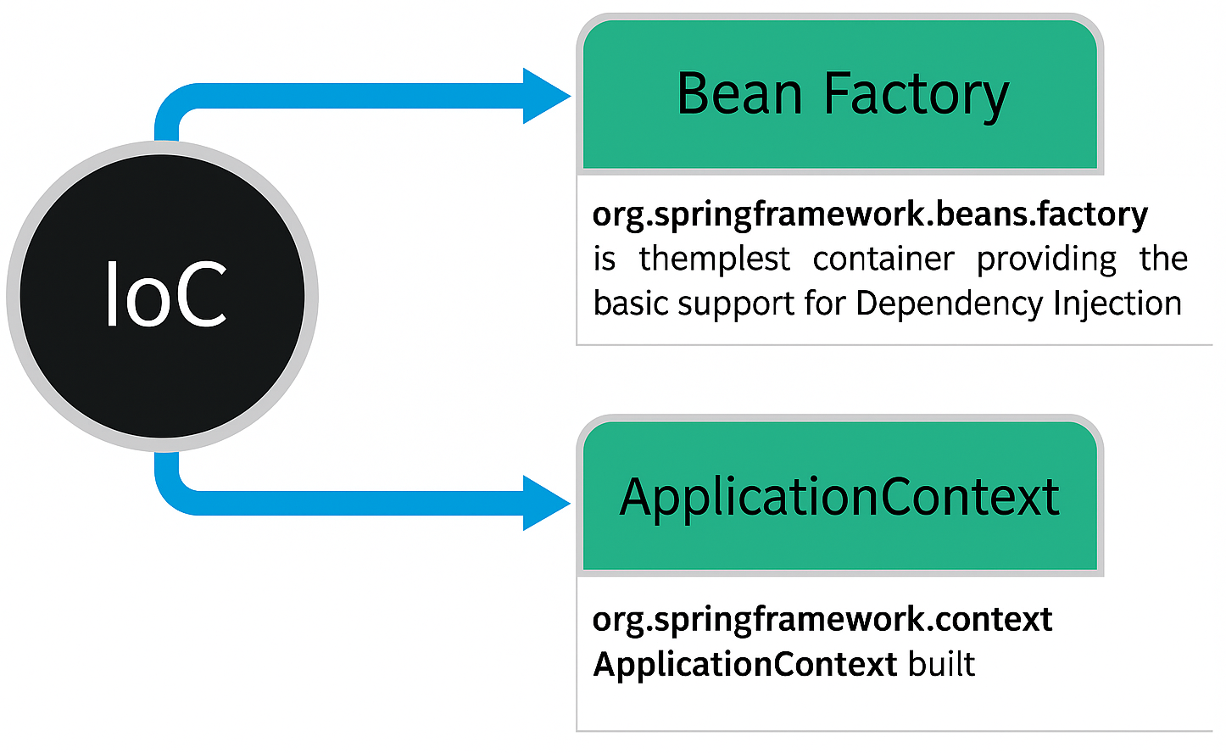
Comparison Bean Factory vs Application Context

Slide 42
Comparison Bean Factory vs Application Context
Feature | BeanFactory | ApplicationContext
Bean Creation | Lazy | Eager (default)
Memory Use | Lightweight | Slightly heavier
Event Handling | ❌ | ✅ Supported
Internationalization | ❌ | ✅ Supported
Annotation Config | ❌ | ✅ Supported
Web App Integration | ❌ | ✅ Supported
Recommended For | Small apps | Almost all apps

Slide 43
IOC container
5. Configuration Options
IoC container can load bean definitions from:
XML configuration (beans.xml)
Annotations (@Component, @Service, @Repository, @Controller)
Java Config (@Configuration + @Bean methods)

Slide 44
IOC container
6. Lifecycle Managed by IoC
Instantiate bean
Populate dependencies
Initialize (@PostConstruct, InitializingBean)
Use bean
Destroy (@PreDestroy, DisposableBean)

Slide 45
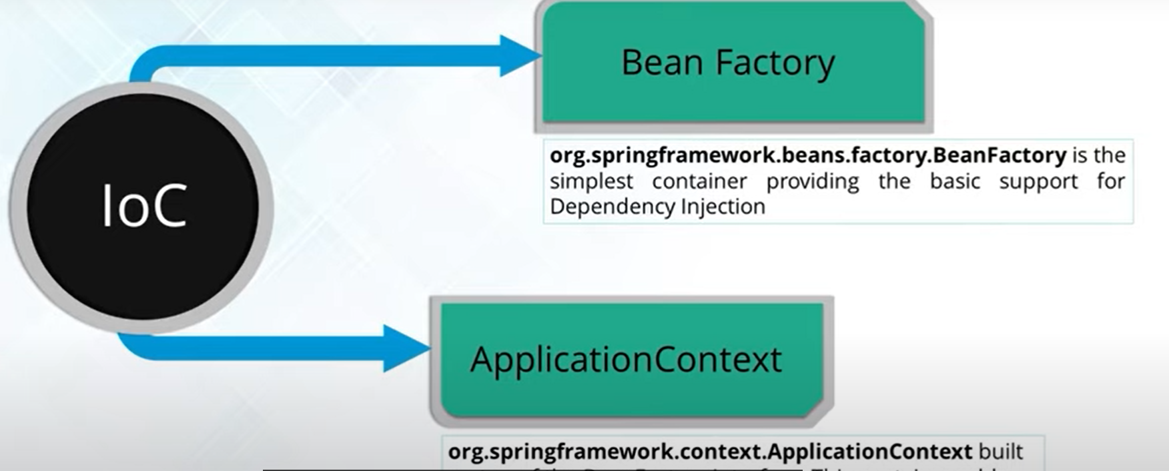
Types of IOC containers

Slide 46
Spring Core Containers Overview
Spring's Container uses IoC to manage components of the application.
Spring has two distinct containers
Bean Factories: (org.springframework.beans.factory.BeanFactory), provides support for Dependency Injection
Application contexts: (org.springframework.context.ApplicationContext) provides application framework services
11
Notes:
Faculty Notes:
Review key slide points and participant notes.
Animation on slide:
On display: IoC text box
On click: “Spring has two distinct containers” appears
On click: Bean Factories and application contexts appears
Participant Notes:
Other services provided by ApplicationContext, apart from bean creation, are:
Resolving text messages from the properties file.
Providing a generic way to load file resources and images.
Publishing events to bean that are registered as listeners.

Slide 47
Bean
Definition
A Spring Bean is simply an object that is:
Instantiated
Assembled
Managed by the Spring IoC Container.

Slide 48
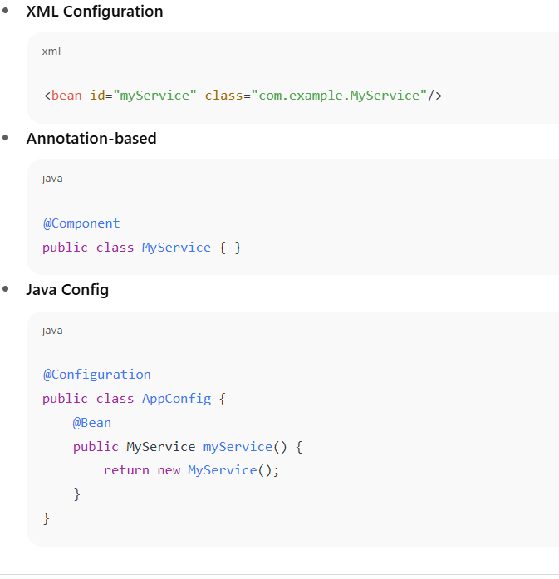
Bean
2. How Beans are Defined
Beans can be defined in multiple ways:

Slide 49
Bean
3. Bean Lifecycle
Spring manages a bean’s lifecycle:
Instantiate – IoC container creates the object.
Populate Properties – Injects dependencies (DI).
Initialize – Calls init methods (@PostConstruct, InitializingBean).
Use – Bean is ready for application use.
Destroy – On shutdown, calls destroy methods (@PreDestroy, DisposableBean).

Slide 50
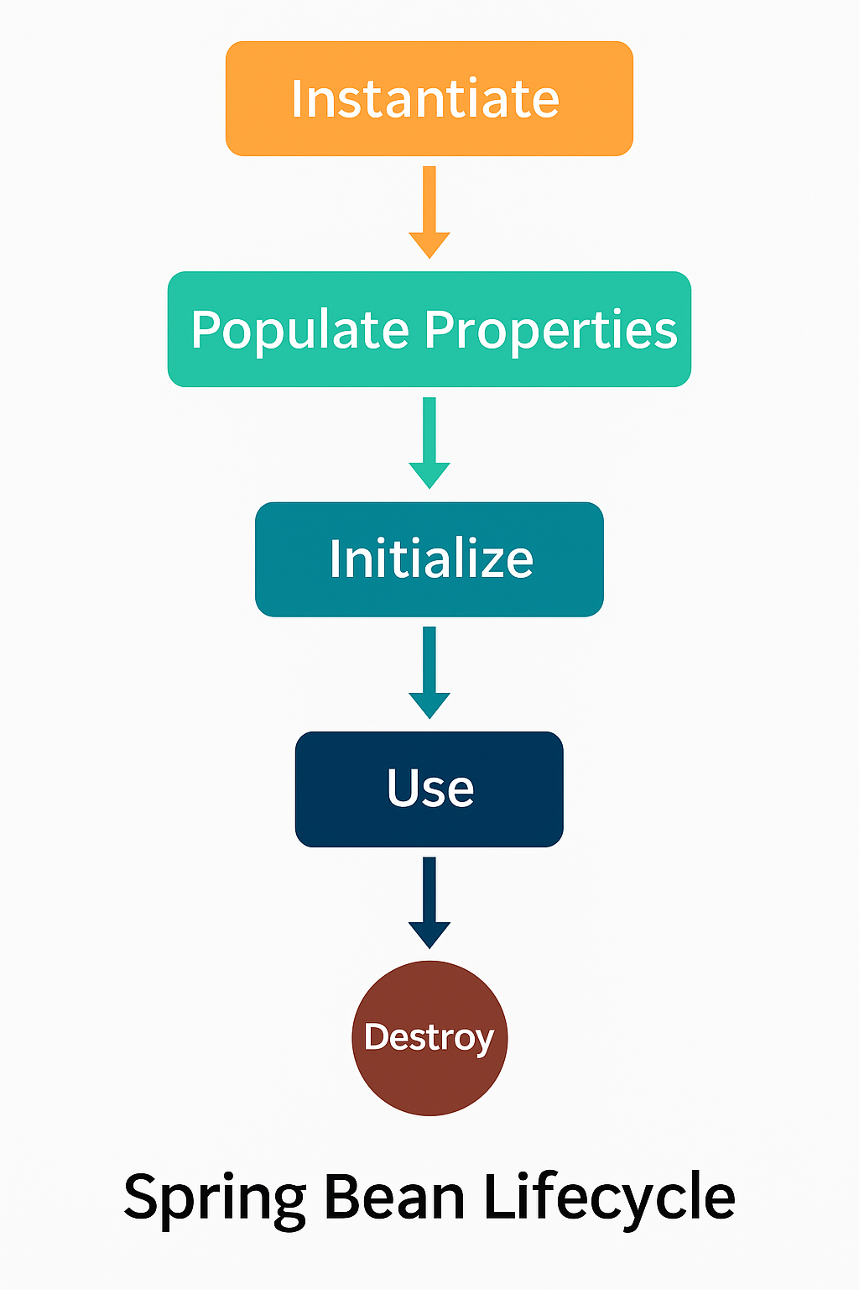
Bean

Slide 51
Bean
Bean Scopes
Spring defines how long a bean lives:
singleton → One instance per container (default).
prototype → New instance every request.
request → One per HTTP request.
session → One per HTTP session.
application → One per ServletContext.

Slide 52
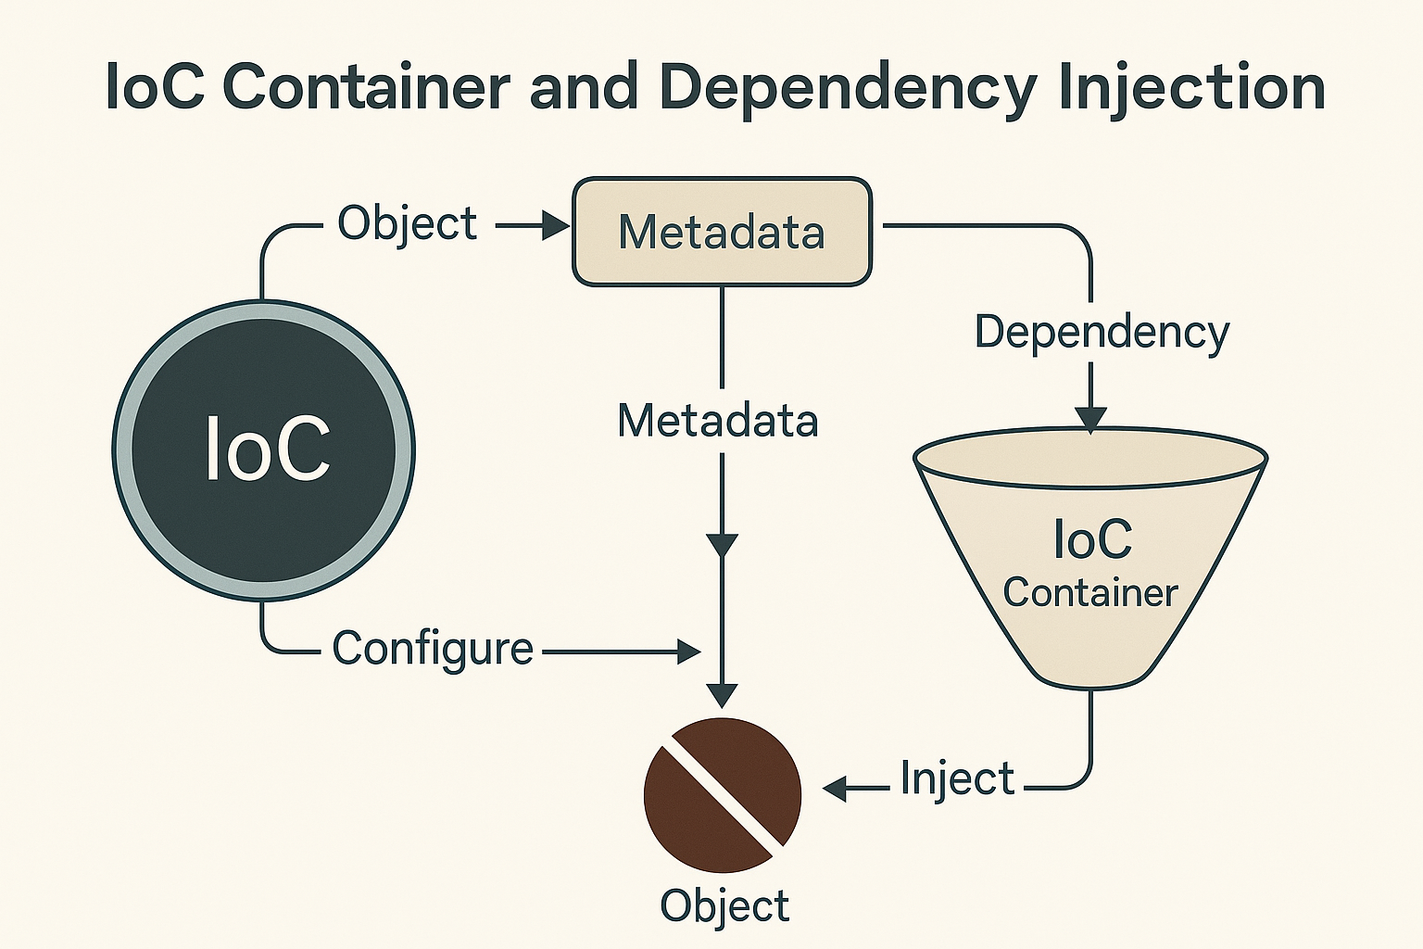
Bean

Slide 53
Bean
Role of IoC Container
The Spring IoC Container:
Instantiates the bean
Wires dependencies
Configures properties
Manages the entire lifecycle (init → use → destroy)

Slide 54
Bean
Metadata + Container = Bean
The configuration metadata (XML, annotations, or Java Config) tells Spring how to create and wire beans.
IoC Container reads this metadata → creates and manages Bean objects.

Slide 55
Bean
Benefits
Centralized configuration
Easy swapping of implementations
Lifecycle automatically managed
Works with dependency injection for loose coupling

Slide 56
Dependency Injection
What is Dependency Injection?
Design Pattern Removes dependencies from programming code, making applications easier to manage and test.
Loose Coupling DI ensures the code is loosely coupled. This means implementation changes don’t affect the user of that code.

Slide 57
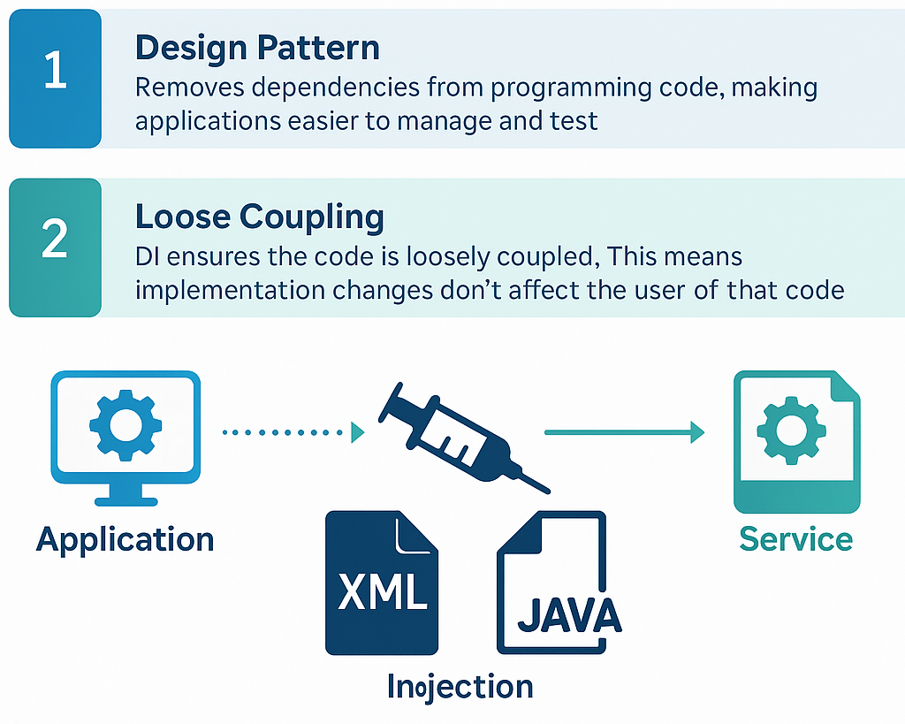
Dependency Injection

Slide 58
Spring Core Containers Dependency Injection
Java classes should be as independent as possible from each other.
To decouple classes from one another, dependencies should be injected through:
Constructors
Setters
Spring Framework injects these dependencies via their containers.
A class should not configure itself, IoC uses dependency injection to:
Configure a class correctly from outside the class
Wire services or components
12
Notes:
Faculty Notes:
Review key slide points and participant notes.
Participant Notes:
Java classes sometimes borrow functionality from other classes.
Java classes should be as independent as possible from other Java classes.
To ensure that Java classes are decoupled from one another, dependency from one class should be injected into another, rather than the class itself creating the object.
For example, if class A has a dependency with class B, rather than creating an object of class B in class A, you can use DI (dependency injection)
Class B is given to class A in one of two ways:
Via the constructor of class A, called construction injection
Via a setter, called setter injection
Setter Injection is the preferred method compared to constructors.
Spring Framework helps in injecting dependencies via their containers.
The general concept of dependency injection is that a class should not configure itself; it should be configured from outside of the class.
Inversion of Control (IoC ) uses dependency injection to configure a class correctly, from outside of the class.
This technique can be used to ‘wire’ services or components to an application.

Slide 59

Spring Core Containers Configuring Beans (1 of 2)
Piecing together all beans in the Spring Container is called wiring.
Wiring can be done through xml.
Various BeanFactories and ApplicationContext objects that support wiring are:
XmlBeanFactory
ClassPathXmlApplicationContext
FileSystemXmlApplicationContext
XmlWebApplicationContext
13
Notes:
Faculty Notes:
Review key slide points.
Participant Notes:
N/A

Slide 60
Spring Core Containers Configuring Beans (2 of 2)
The beans are listed in the configuration file so that they can later be referred to by application programs.
Example:
<? xml version=“1.0” encoding=“UTF-8”?>
<!DOCTYPE beans PUBLIC “-//SPRING//DTD BEAN// EN” “http://www.springframework.org/dtd/spring-beans.dtd”?>
<beans>
<bean id=“event” class=“com.accenture.adf.newcodington.module26.sample.Event”/>
</beans>
14
Notes:
Faculty Notes:
Review key slide points and participant notes.
Animation on slide.
On Display: Text
On Click: Example
Participant Notes:
The beans are listed in the configuration file so that they can later be referred to by application programs.
In order to get an Event object created, you need to refer to it using its id “event”.
The slide example shows how Event class is configured in a Spring Configuration file.

Slide 61
Spring Core: See It
Demonstration:
Faculty will demonstrate how to create a Spring Core application to print a greeting along with a name.
Time Allocated: 20 minutes
Environment or File: Eclipse
Steps:
Open the project Week2CodebaseM26_participant
Navigate to Java Resources/src.
Open package com.accenture.adf.newcodington.module26.sample.
Complete TODOs in
HelloSeeIt.java
HelloSeeItImpl.java
HelloSeeItClient.java
Complete helloSeeIt.xml.
15
Notes:
Faculty Notes:
The fully annotated demonstration code is found in the Faculty Guide. You may use this to guide you through the demo. However, for the purposes of the demonstration, please create new code from scratch while sharing your screen with the entire class and talking through each step.
Demonstrate how to create a Spring Core application to print a greeting along with a name.
This demo requires the following jars to be present in the classpath: spring-core.jar, commons-logging.jar and spring-beans.jar
This demo also tests Singleton design pattern.
Open the project Week2CodebaseM26_participant
Navigate to Java Resources/src.
Open package com.accenture.adf.newcodington.module26.sample.
Complete TODOs in
HelloSeeIt.java
HelloSeeItImpl.java
HelloSeeItClient.java
Complete helloSeeIt.xml.
Participant Notes:
Pay attention as your faculty member creates the Spring Core application. You will be asked to create one after this demonstration.

Slide 62
Spring Core: Try It
Now You Try It:
Create a Spring Core application to add two numbers and print the sum.
Time Allocated: 30 minutes
Environment or File: Eclipse
Steps:
Open the project Week2CodebaseM26_participant
Navigate to Java Resources/src.
Open package com.accenture.adf.newcodington.module26.sample..
Complete TODOs in
NumberTryIt.java
NumberTryItImpl.java
NumberTryItClient.java
Complete numberTryIt.xml.
16
Notes:
Faculty Notes:
The fully annotated solution code is found in the Faculty Guide.
Present the task that participants must try themselves.
Walk around the room in case anyone needs assistance.
Participant Notes:
Create a Spring Core application to add two numbers and print the sum.
Open the project Week2CodebaseM26_participant
Navigate to Java Resources/src.
Open package com.accenture.adf.newcodington.module26.sample..
Complete TODOs in
NumberTryIt.java
NumberTryItImpl.java
NumberTryItClient.java
Complete numberTryIt.xml.

Slide 63
Spring Core: Solution
Your faculty will now provide you with the Solution to check and update your file.
17
Notes:
Faculty Notes:
The fully annotated solution code is found in the Faculty Guide.
Participant Notes:
N/A

Slide 64
Activity 1: Spring Core
Objective:
Write/modify an application based on Spring Core which will update and then display a record in the Zoo table.
Instructions:
Navigate to the Module 26, Activity 1 page on the course web site.
Follow the instructions provided on the web page to locate the codebase, launch Eclipse and complete the activity.
18
Notes:
Faculty Notes:
Introduce the objectives of the activity.
The suggested duration is 35 minutes but conclude the activity early if learners finish early.
Participant Notes:
Navigate to the Module 26, Activity 1 page on the course web site.
Follow the instructions provided on the web page to locate the codebase, launch Eclipse and complete the activity.

Slide 65
Module Summary
The key content points from this module are:
Spring is a lightweight container that makes Java EE and existing technologies easy to use.
Spring Framework has seven modules. Each module has a set of functionalities and can be used independently.
Spring's Container uses IoC to manage components of the application.
Spring has two distinct containers:
BeanFactory
ApplicationContext
19
Notes:
Faculty Notes:
Discuss the module summary briefly.
Participant Notes:
The Spring Core module remains the base for all other modules. It will be used during the Weeks 3 and 4 simulation of this school.

Slide 66
Questions and Comments
20
Notes:
Faculty Notes:
Ask participants for any questions or comments they may have.
Participant Notes:
N/A

